Slide 1

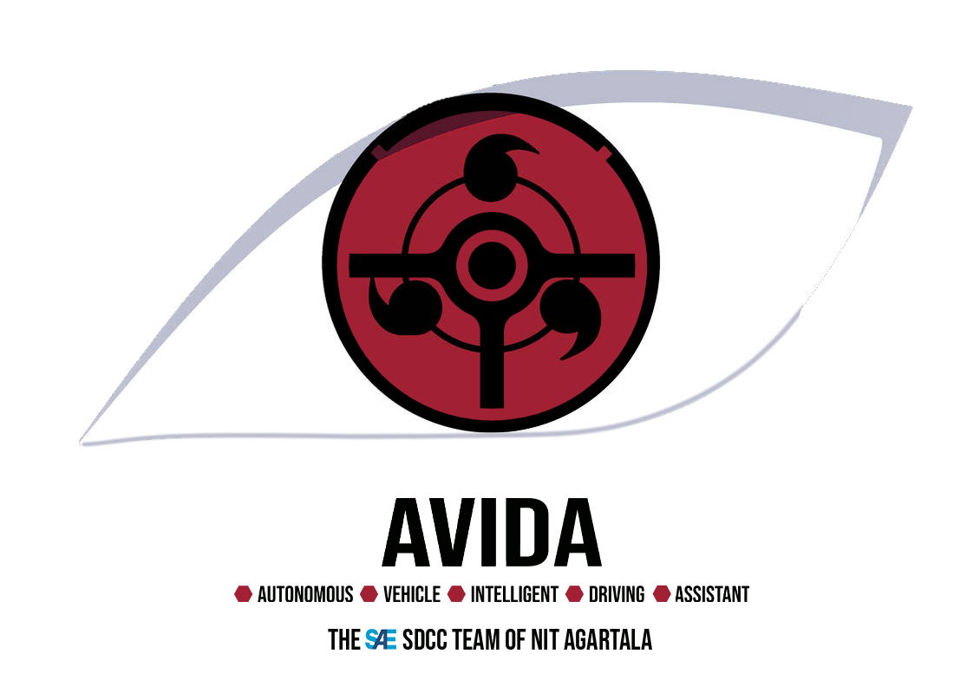
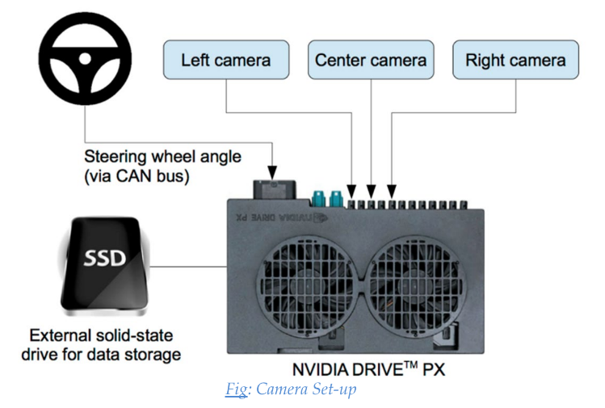
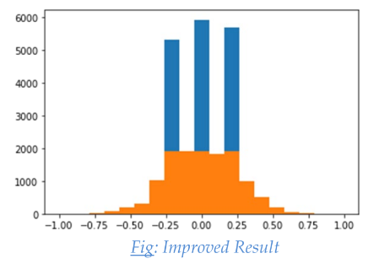
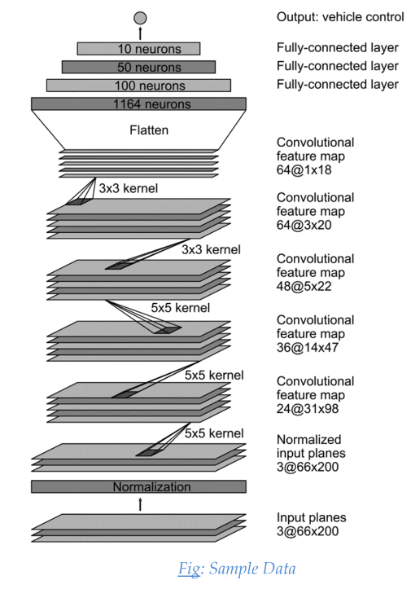
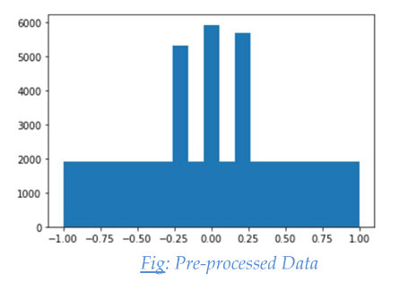
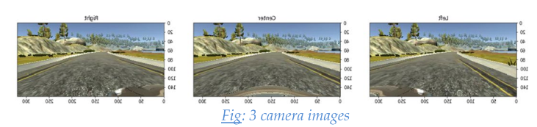
Team AVIDA
Behavioral Cloning
Anawil Tiwari. Krushna Borude.Sumit Ananda
Abstract
Methodology
Conclusions
To have any idea to start this project, the CNN that was eventually used
was based on NVIDIA’s End to End Learning for Self-Driving Cars paper
with different input image size and with dropout added to improve
robustness. From the paper, data collection is the first important part. Per
project requirement, data collection can only performed on Track 1. We
drove about 4 laps around Track 1 by keyboard control to collect data. The
driving wasn’t extrememly smooth as actual driving. So we decided to use
Udacity sample data as starting point.
(Data Collection)
Understanding Data:
Training and Validation:
Data Pre-processing:
Optimizing the Model:
Challenges with the project:
This project of Udacity is a challenging one specially for beginners in
machine learning. This one involves collecting the training data by self. The
task of collecting training data, devising a strategy for it can itself be
daunting at first. Next comes the difficulty in setting up the model,
processing the input data and optimizing the model parameters. More often
we might have concluded that its impossible to solve. The project is based
on deep learning, but it provides scope for us to learn deeply. That’s the
only way to solve this problem. Once we saw the car navigating the track
with help of my trained model, the entire struggle to solve this problem
vanished and we were filled with sheer joy.
Results
Introduction
In this project, we design, train, and test a convolutional neural network
(CNN) to clone the driving behaviour from sample images recorded
from Udacity’s driving simulator.
Behavioral cloning is a method by which human sub-cognitive skills can be
captured and reproduced in a computer program. As the human subject
performs the skill, his or her actions are recorded along with the situation
that gave rise to the action. A log of these records is used as input to a
learning program.
The goals / steps of this project are the following: Use the simulator to
collect data of good driving behavior Build, a convolution neural network
(using Keras) that predicts steering angles from images Train and validate
the model with a training and validation set Test that the model
successfully drives around the track without leaving the road
Figure 1. Label in 24pt Calibri.
Data collection
Model Architecture
Training And Validation
Data Pre-Processing
Optimization Of Model
Contact
References
Team AVIDA
Team Id –SDCC2021001
National Institute of Technology, Agartala.
LinkedIn: Team Avida/LinkedIn
Phone:7905155527
https://github.com/navoshta/behavioral-cloning
https://github.com/naokishibuya/car-behavioral-cloning
https://medium.com/@madhusudhan.d/guiding-self-driving-car-using-behavioral-cloning-9c24541a425d
https://tina-chien-tw.medium.com/behavioral-cloning-project-3fadf2ae0db2
https://towardsdatascience.com/behavioural-cloning-applied-to-self-driving-car-on-a-simulated-track-5365e1082230

